Slide 1
Bot Trader
12-07-2023
Sivaprasad
Kasikrishna

Slide 2
What is a trading bot?
Trading bot or automated trading system, is a software program that executes trades on financial markets automatically, based on predefined rules and algorithms
These bots are designed to analyze market data, such as price movements, volume, and other indicators, and make trading decisions without human intervention
Trader bots can be programmed to trade in various financial markets, including stocks, cryptocurrencies, foreign exchange (forex), commodities, and more

Slide 3
It is important to note that trading bots are not guaranteed to generate profits.
The effectiveness of a trader bot depends on the quality of its programming, the chosen strategy, and the prevailing market conditions. Additionally, market volatility, unexpected events, and technical glitches can also impact the performance of trading bots.
Therefore, it's essential to thoroughly test and monitor a trading bot's performance and have a good understanding of the underlying market dynamics before relying on it for trading activities.

Slide 4
History of TradeBot
Automated trading system was first introduced by Richard Donchian in 1949
Algorithmic trading gained momentum in the 1990s
Trader bots have increased market liquidity, improved price efficiency, and reduced transaction costs
Early 2000s, algorithmic trading became more accessible to individual traders and smaller firms
Today, tradebots leverage machine learning and big data analytics to analyze market data and execute trades
Video reference link followed: I Built a Trading Bot with ChatGPT - YouTube

Slide 5
General flow diagram
OpenAI’s deep reinforcement learning techniques can be applied
OpenAI’s gym platform
Accessing historical market data
Preprocessing data
Creating a trading environment
Applying reinforcement learning model (A2c)
Historical data can be accessed using Alpaca API or Yahoo finance
Buy/Sell actions taken based on sharpe ratio and rewards
Returns are calculating based on market data (price based)
For Market data and trade data:
If sharpe ratio>0.4 buy action,
If reward < 0.02 of previous reward, selling action
Sharpe ratios are calculated based on market data based returns as well as by using trade based returns. Based on this buy and sell action are taking place parallelly for both cases
Buy/Sell actions taken based on sharpe ratio and rewards
Returns are calculating based on trade data (action based)

Slide 6
Architecture diagram
Web application front end
REST API
Link to Access the trading bot
Trading bot
Order management using market data as well and trade data (paper trading)
For Market data and trade data:
If sharpe ratio>0.4 buy action,
If reward < 0.02 of previous reward selling action
Data fetching API
Trading algorithm
(A2C)
Deep Reinforcement Learning algorithms for model training and returns calculations
To fetch historical trading data we can use Alpaca API or Yahoo finance aapi

Slide 7
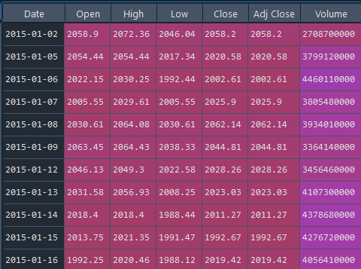
What is historical trade data?
Historical transaction data, refers to a record of past trades executed in the financial markets. It includes detailed information about each individual trade, such as the time of the trade, the price at which the trade occurred, the volume or quantity of shares or contracts traded, and sometimes additional data like the trade type (buy or sell), the exchange where the trade took place, and the trader or institution involved

Slide 8
How we can access historical trade data?
There are several platforms and libraries that can be used to fetch real-time and historical stock data using Python
Alpaca
Yahoo Finance
Quandl
Intrinio
Alpha Vantage
Polygon.io
IEX Cloud

Slide 9
Alpaca API
Alpaca is a brokerage and technology company that offers an API for accessing and trading. The Alpaca API provides developers with a simple and reliable way to interact with Alpaca's trading platform programmatically.
With the Alpaca API, you can perform various tasks, including:
Place market and limit orders to buy or sell stocks.
Retrieve real-time and historical market data, including stock prices, volume, and quotes.
Access account information, such as buying power, positions, and portfolio history.
Receive real-time trade and order updates through websockets.
Paper trading for testing strategies without using real money.

Slide 10
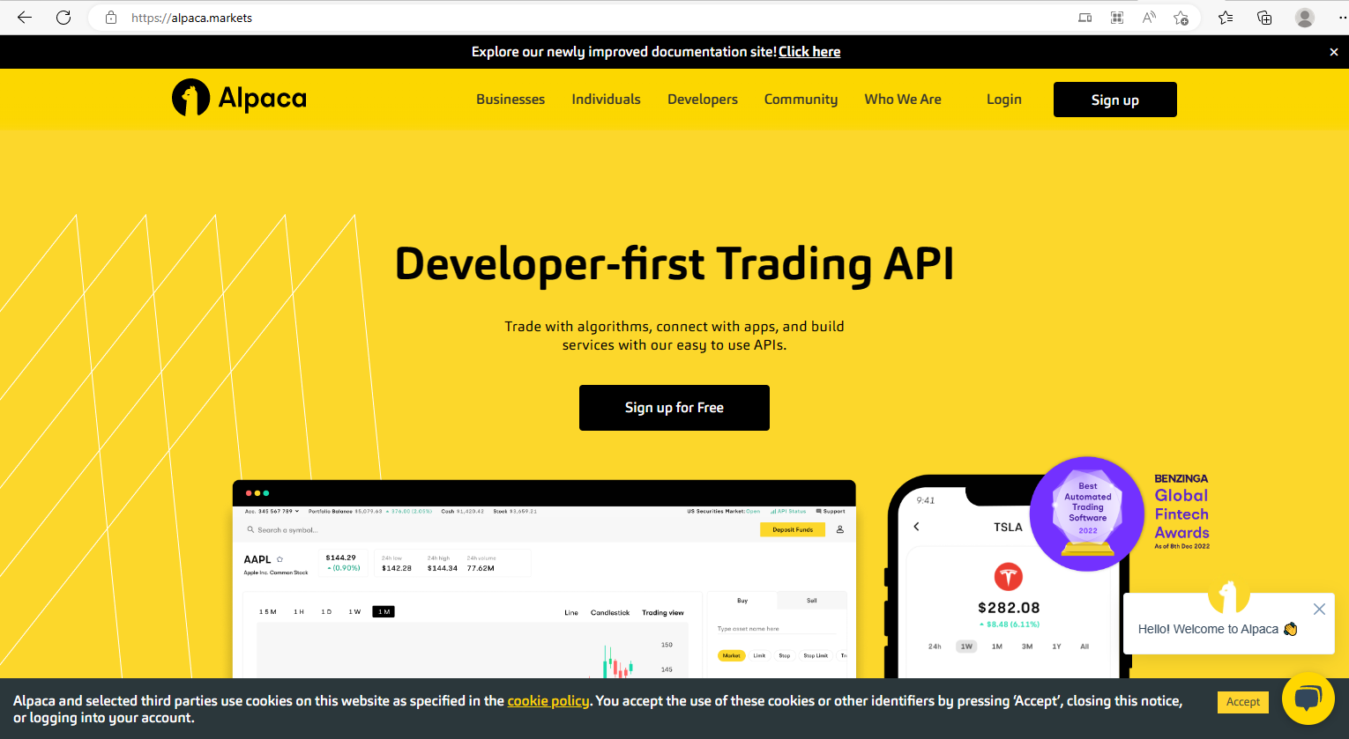
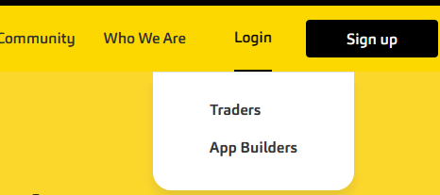
Alpaca API
We can access it using this link
Alpaca - Developer-First API for Trading
Click on Login—> Traders

Slide 11
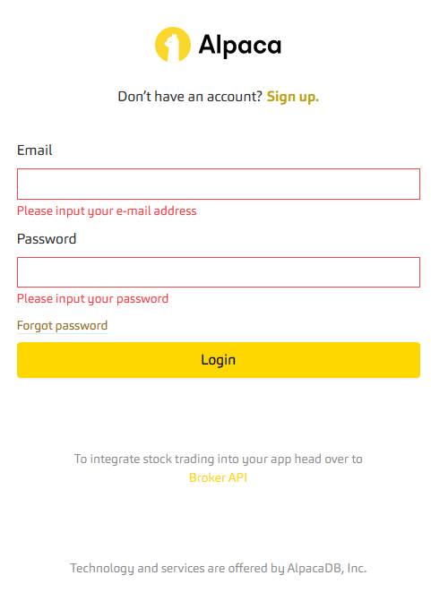
Alpaca API
We can sign up using our credentials
In our account we have view API keys option Below we have a generate key option
Once generated we will get API KEY and SECRET KEY, we can use this in our code for data fetching

Slide 12
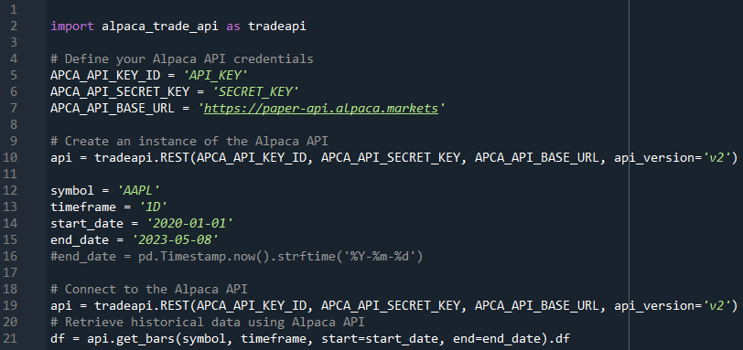
Accessing data using Alpaca API
We need to create an Alpaca account and generate API key, it can be given here
We need to give secret key here
We need to give Stock name here
We need to give Time frame here
We need to give start date here
We need to give end date here

Slide 13
Gym environment
Gym refers to the OpenAI Gym library, which is a popular toolkit for developing and comparing reinforcement learning (RL) algorithms. It provides a collection of pre-defined environments for RL tasks, including various control problems and games.
Gym Anytrading is an extension of the OpenAI Gym library specifically designed for trading and finance-related tasks. It provides a set of trading environments that allow you to simulate and test trading strategies using RL algorithms.
Gym Anytrading provides an interface for creating custom trading environments with historical price data, allowing you to define trading rules, actions, and rewards. It also includes built-in functionality for visualizing and analyzing the performance of trading strategies.

Slide 14
Exploring Reinforcement Learning Methods for Trading Strategies
Reinforcement Learning (RL) is a subfield of machine learning that focuses on decision-making and sequential actions.
RL algorithms learn by interacting with an environment, receiving feedback in the form of rewards or penalties.
In trading, RL can be utilized to develop adaptive and dynamic strategies that learn from market data.

Slide 15
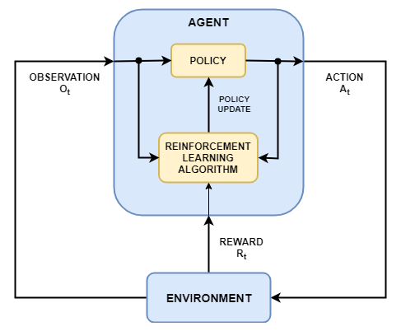
Basic RL diagram

Slide 16
A2C (Advantage Actor-Critic)
A2C is a popular RL algorithm that combines elements of both policy-based and value-based methods.
It utilizes an actor-critic architecture where the actor suggests actions, and the critic evaluates their value.
The advantage function is used to estimate the advantage of taking a specific action compared to the average reward.
A2C provides a balance between exploration and exploitation, enabling effective decision-making in trading.

Slide 17
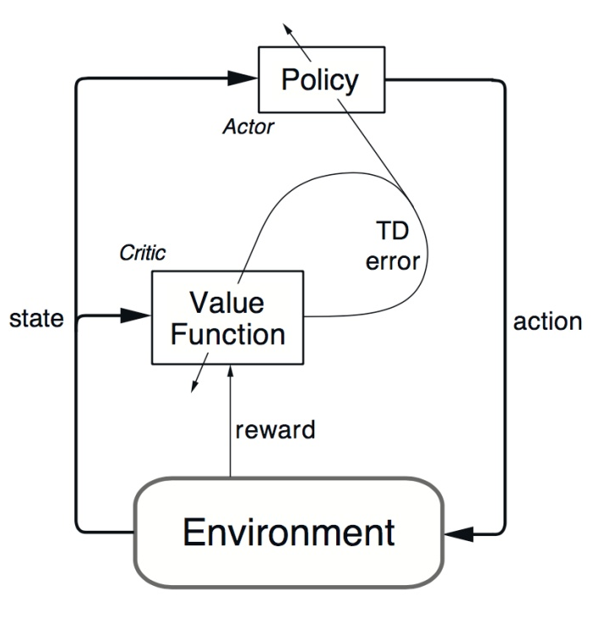
A2C model
Policies used in A2C model
MlpPolicy
CnnPolicy
MultiInputPolicy
MlpLstmPolicy

Slide 18
A2C (Advantage Actor-Critic)
Advantages of A2C:
Simplicity: A2C is a straightforward algorithm that combines policy gradients and value-based methods.
On-policy Learning: A2C learns from the most recent data, making it suitable for changing environments and exploration.
Actor-Critic Architecture: A2C's actor-critic setup provides stable learning by using the critic's value estimates to guide the actor.
Advantage Estimation: A2C uses advantage estimation to reduce variance and improve convergence.

Slide 19
A2C (Advantage Actor-Critic)
Disadvantages of A2C:
High Variance: A2C can suffer from high variance, requiring techniques like advantage normalization or baselines.
Exploration Efficiency: A2C may struggle with exploration efficiency, especially in complex environments.
Sample Efficiency: A2C requires a significant number of interactions with the environment, making it less sample-efficient.
Lack of Parallelism: A2C's on-policy nature limits parallelization during training.
In summary, A2C is a popular and effective algorithm, but it has limitations in terms of variance, exploration efficiency, sample efficiency, and parallelization.

Slide 20
Reasons for Choosing A2C
Library Compatibility
Simplified Implementation
Time and Resource Constraints
Solid Foundation

Slide 21
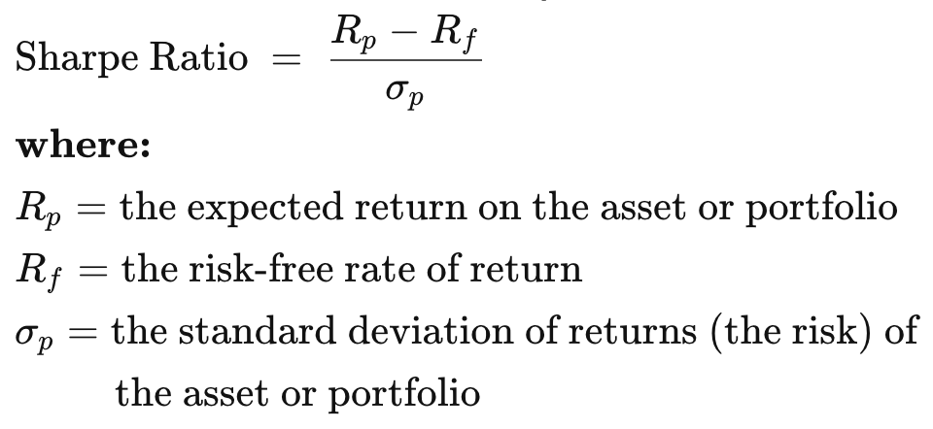
Sharpe ratio
The Sharpe Ratio is a mathematical formula which measures the performance of an asset or a group of assets relative to their assumed risk.
Formulatically, the Sharpe Ratio is the expected returns of an asset, minus the risk-free rate, divided by the standard deviation of excess returns, which is a measure of volatility.
Take actions based on sharpe ratio value for both trade based and market based approaches.
If sharpe ratio>0.4 buy action
If reward < 0.02 of previous reward selling action

Slide 22
Paper trading
Paper trading is simulated trading that allows investors to practice buying and selling securities.
Paper trading can test a new investment strategy before employing it in a live account.
Many online brokers offer clients paper trade accounts.
Paper trades teach novices how to navigate platforms and make trades, but may not represent the true emotions that occur during real market conditions.

Slide 23
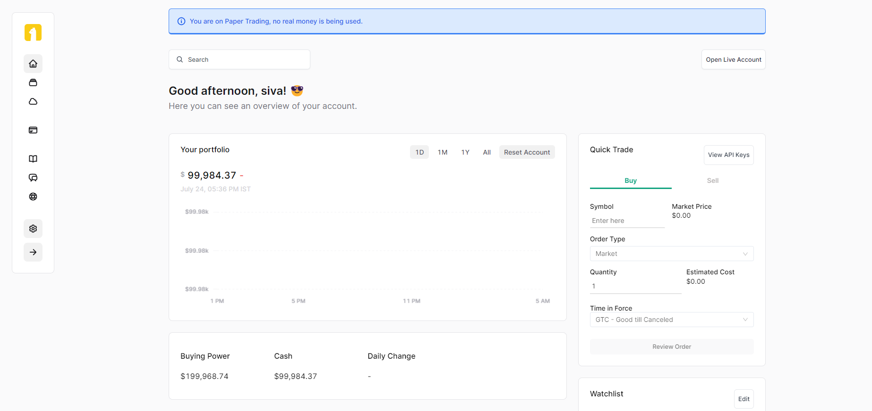
Alpaca Paper trading- account sample
Account balance

Slide 24
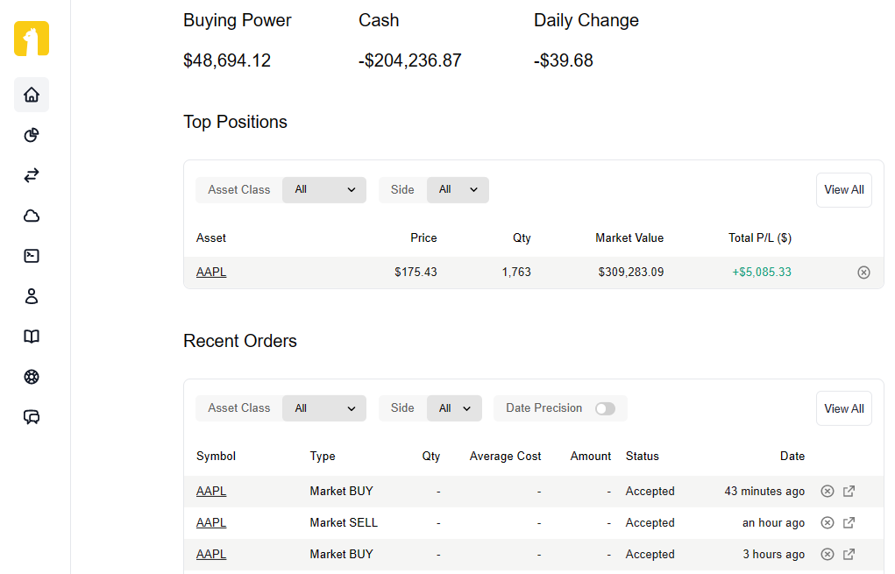
Alpaca Paper trading- account sample
Buying and Selling orders can be visible here

Slide 25
Data fetched using Yahoo finance

Slide 26
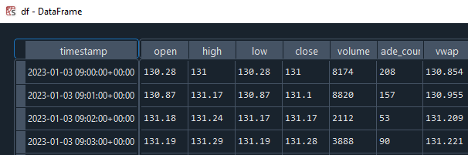
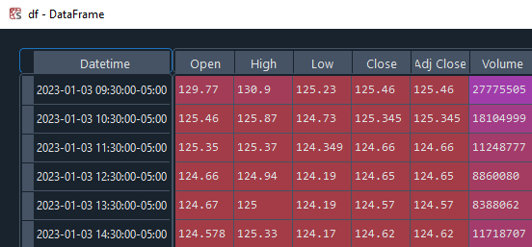
Data fetching
For market data(Closeprice based)
Using Yahoofinance
Timeframe: 1Minute
Timeframe: 1Hour

Slide 27
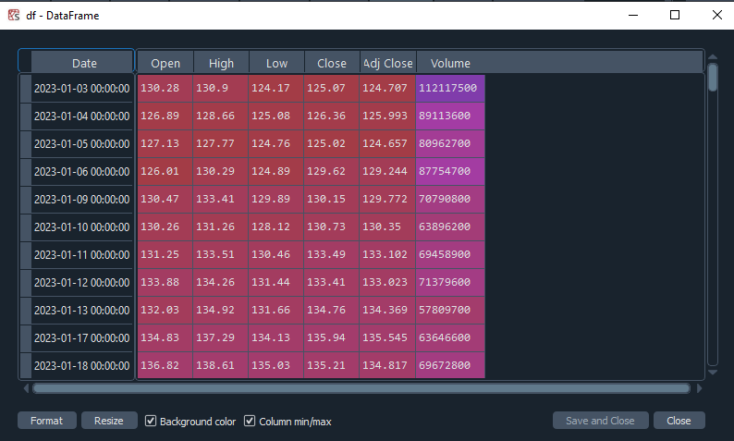
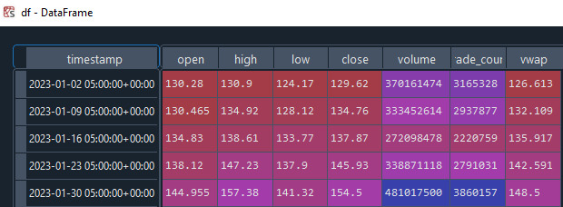
Data fetching
For market data(Closeprice based)
Using Yahoofinance
Timeframe: 1Day
Timeframe: 1Week

Slide 28
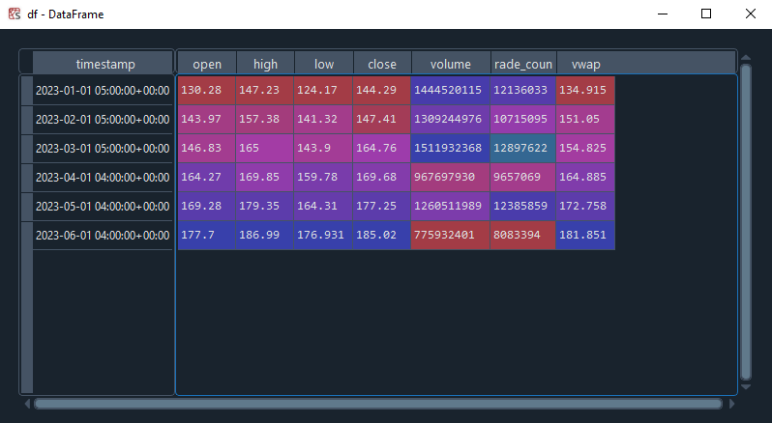
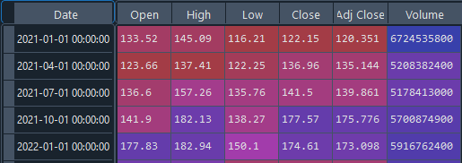
Data fetching
For market data(Closeprice based)
Using Yahoofinance
Timeframe: 1Month
Timeframe: 3Months

Slide 29
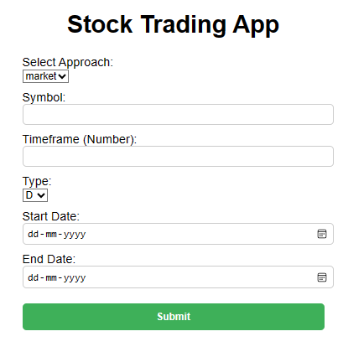
Sample index page
For selecting trading type-
Market/Trade based
Stock symbol (eg:AAPL)
Number of timeframe
Timeframe for data (eg:1D)
Start date for data fetching
End date for data fetching

Slide 30
Market based approach

Slide 31
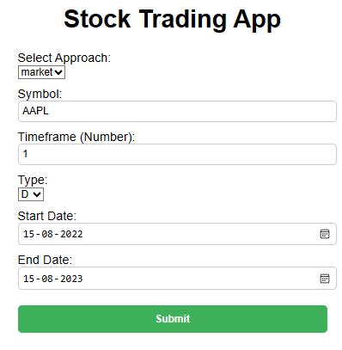
Input html page
Market based (close price) approach
Start_date=2022-08-15 End_date=2023-08-15

Slide 32
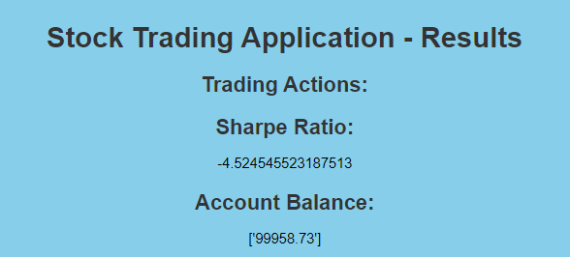
Output html page samples
Market based (close price) approach
Start_date=2022-08-15 End_date=2023-08-15

Slide 33
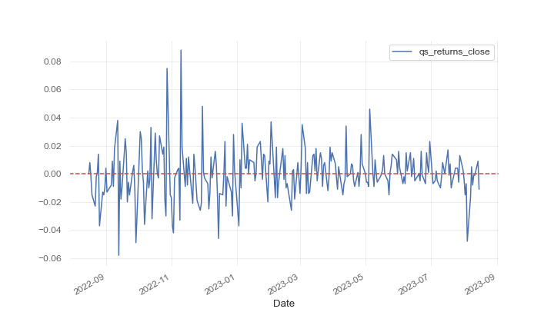
Output html page samples
Returns plot- Close price based
Market based (close price) approach
Start_date=2022-08-15 End_date=2023-08-15
Daily returns plot
Cumulative return: 0.062

Slide 34
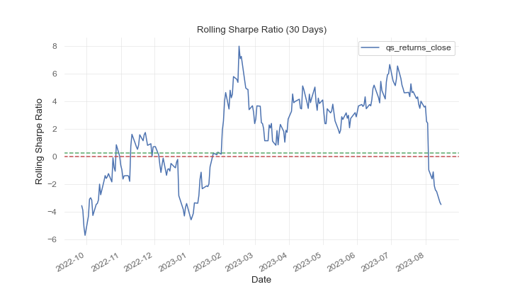
Output html page samples
Rolling sharpe ratio curve- Close price based
Market based (close price) approach
Start_date=2022-08-15 End_date=2023-08-15
Cumulative return: 0.062

Slide 35
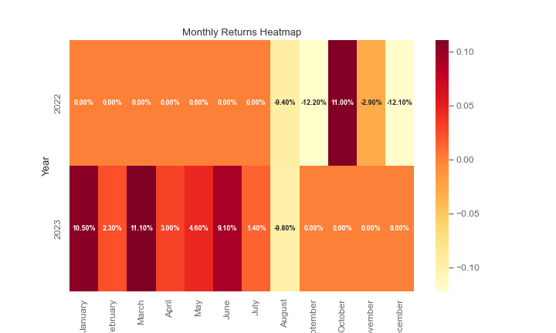
Output html page samples
Monthly return heatmap- Close price based
Market based (close price) approach
Start_date=2022-08-15 End_date=2023-08-15
Cumulative return: 0.062

Slide 36
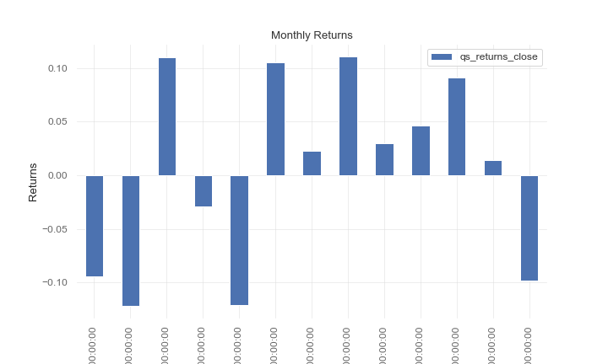
Output html page samples
Monthly return barplot- Close price based
Market based (close price) approach
Start_date=2022-08-15 End_date=2023-08-15
Cumulative return: 0.062

Slide 37
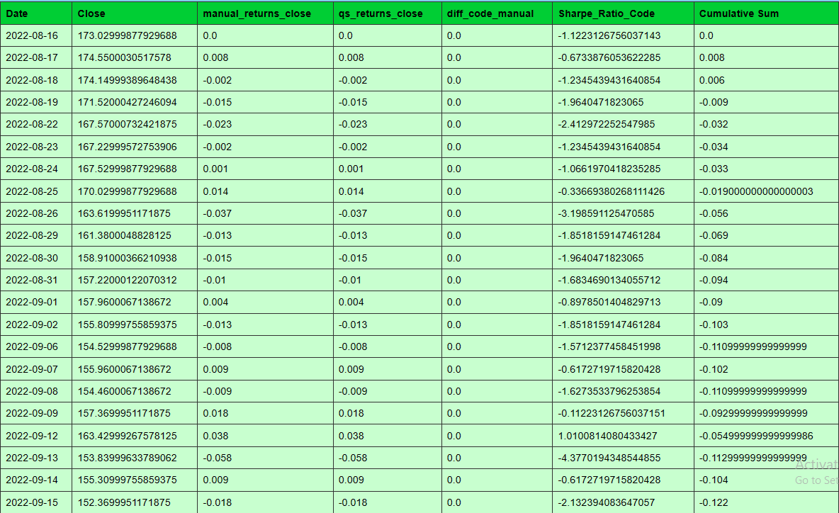
Output html page samples
Returns comparison table- Close price based
Market based (close price) approach
Start_date=2022-08-15 End_date=2023-08-15

Slide 38
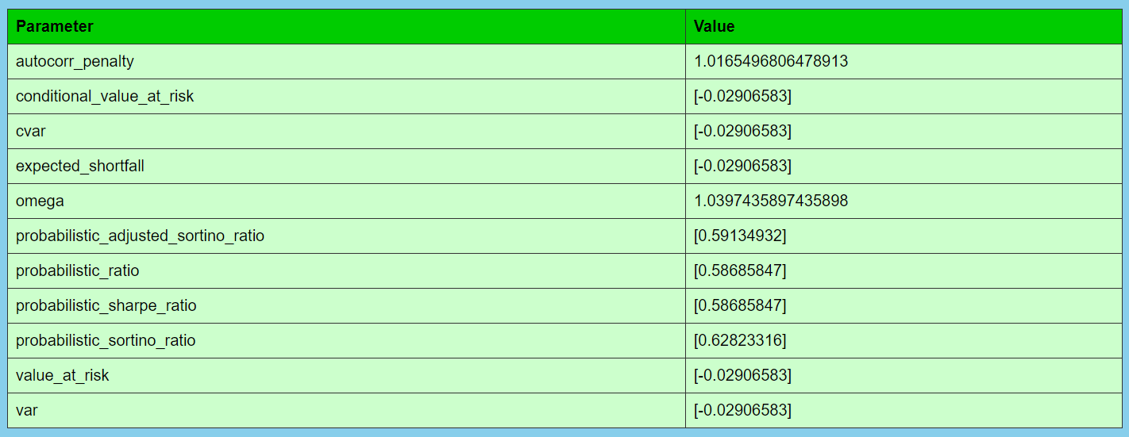
Output html page samples
Monthly return barplot- Close price based
Market based (close price) approach
Start_date=2022-08-15 End_date=2023-08-15

Slide 39
Trade based approach

Slide 40
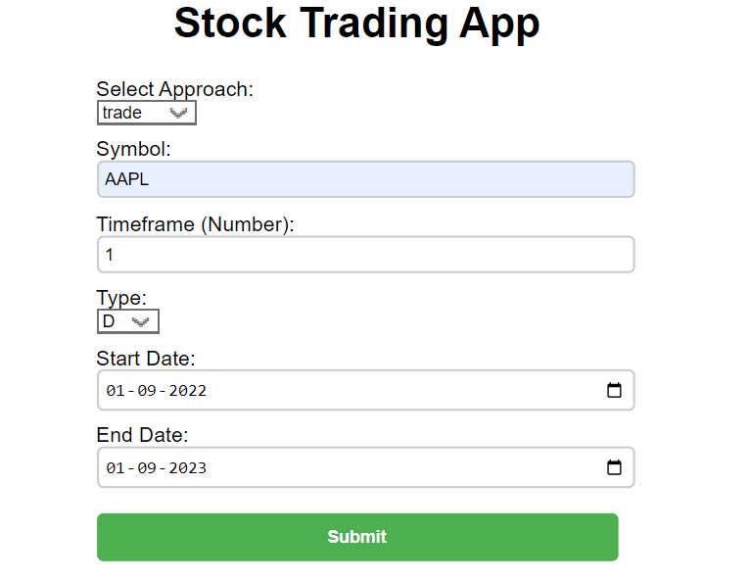
Input html page
Trade based (reward) approach
Start_date=2022-09-01 End_date =2023-09-01

Slide 41
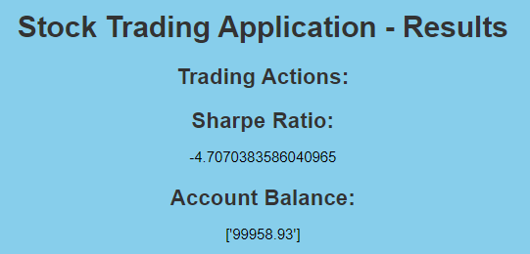
Output html page samples
Trade based (reward) approach
Start_date=2022-09-01 End_date =2023-09-01

Slide 42
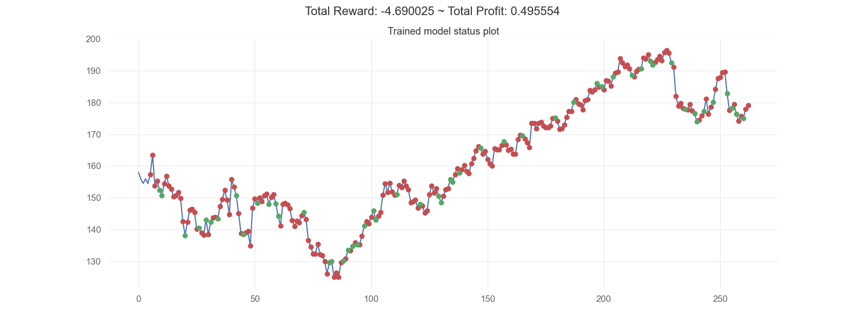
Trained Model Status Plot
Trade based (reward) approach
Start_date=2022-09-01 End_date =2023-09-01

Slide 43
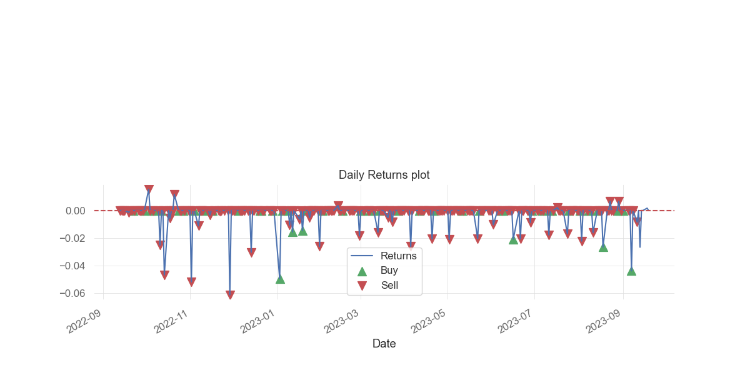
Output html page samples
Trade based (reward) approach
Start_date=2022-09-01 End_date =2023-09-01
Cumulative return: -0.759

Slide 44
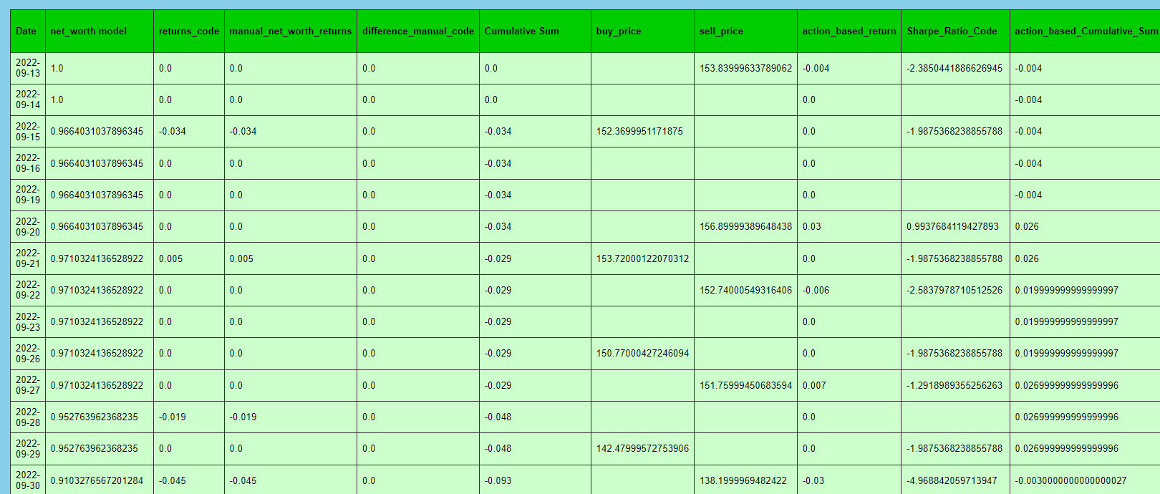
Capturing The Key Factors
Fig: Screenshot of the UI Output

Slide 45
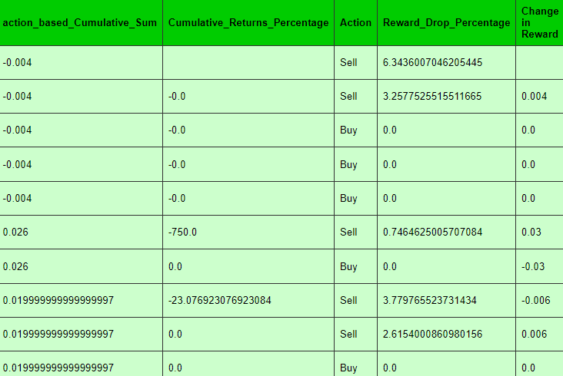
Capturing The Key Factors
Fig: Screenshot of the UI Output

Slide 46
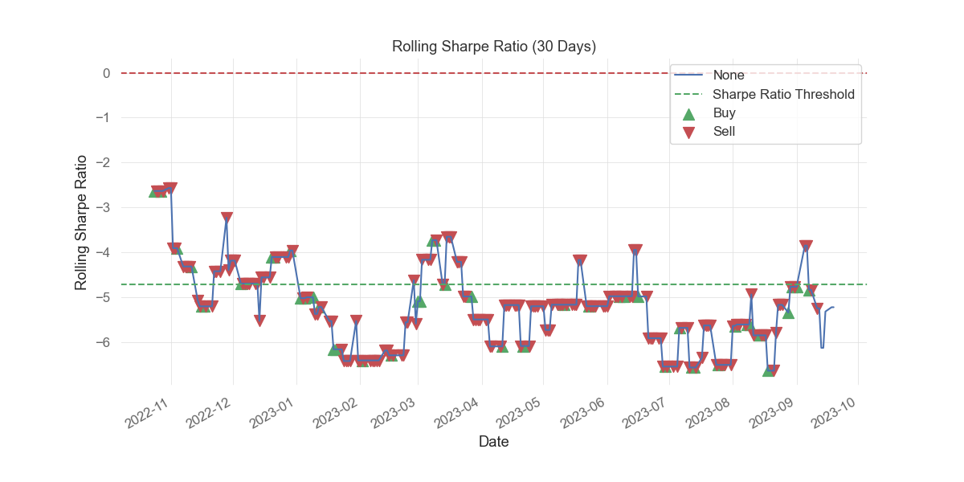
Output html page samples
Rolling sharpe ratio curve
Trade based (reward) approach
Start_date=2022-09-01 End_date =2023-09-01
Cumulative return: -0.759

Slide 47
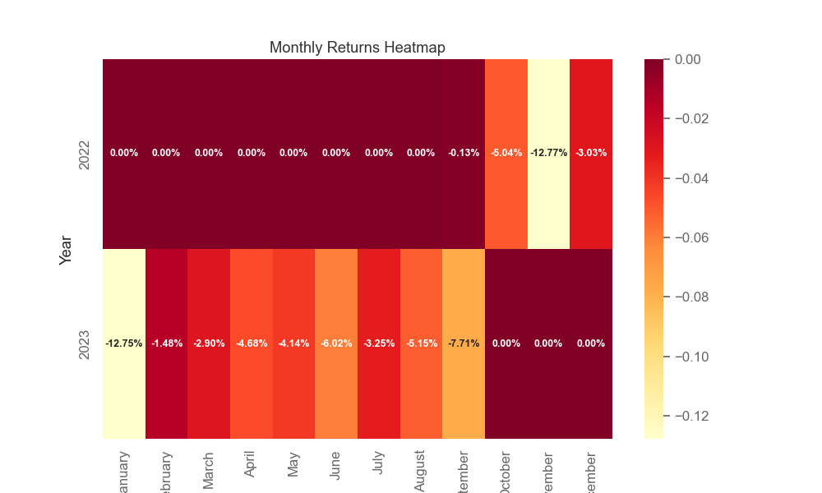
Output html page samples
Monthly return heatmap
Trade based (reward) approach
Start_date=2022-09-01 End_date =2023-09-01
Cumulative return: -0.759

Slide 48
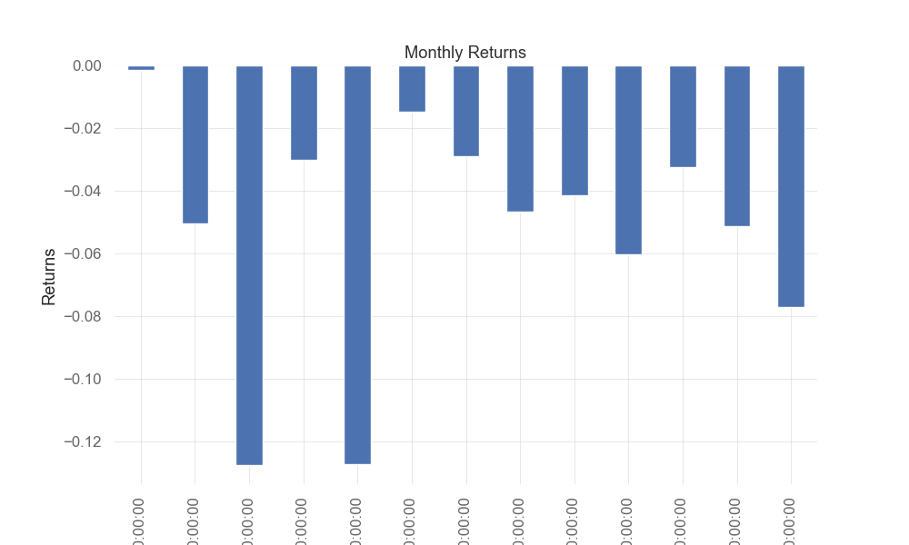
Output html page samples
Monthly return barplot
Trade based (reward) approach
Start_date=2022-09-01 End_date =2023-09-01
Cumulative return: -0.759

Slide 49
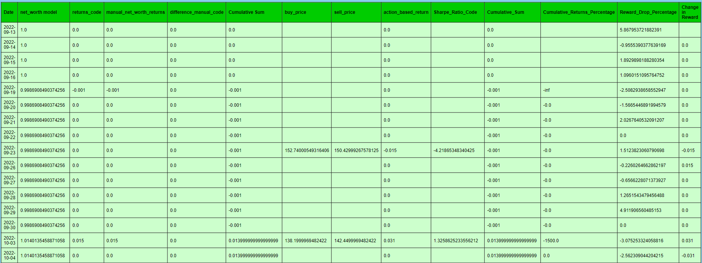
Output html page samples
Returns comparison table
Trade based (reward) approach
Start_date=2022-09-01 End_date =2023-09-01

Slide 50
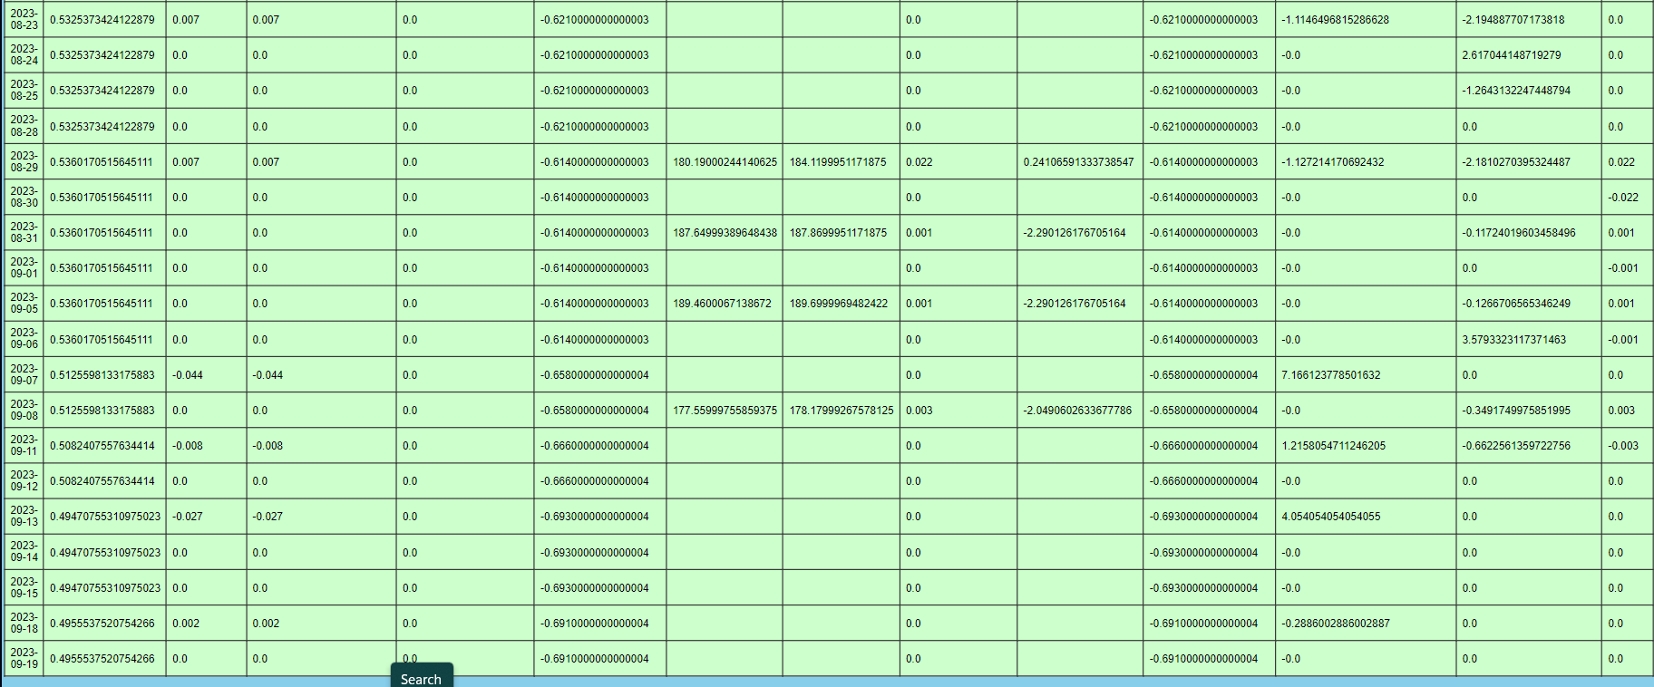
Output html page samples
Returns comparison table
Trade based (reward) approach
Start_date=2022-09-01 End_date =2023-09-01

Slide 51
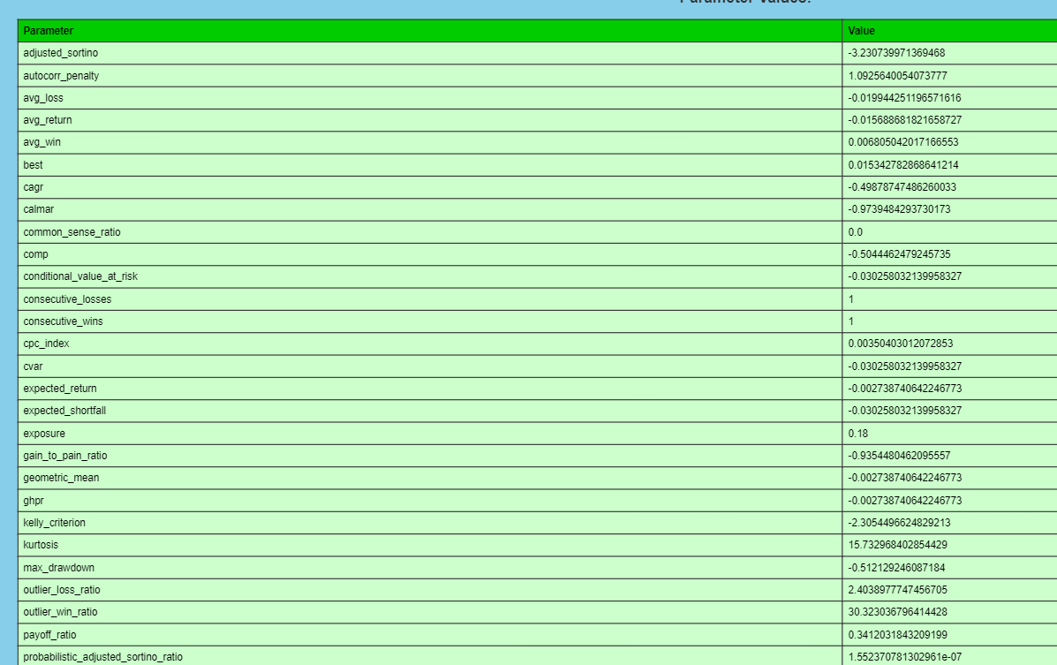
Output html page samples
Monthly return barplot
Trade based (reward) approach
Start_date=2022-09-01 End_date =2023-09-01

Slide 52
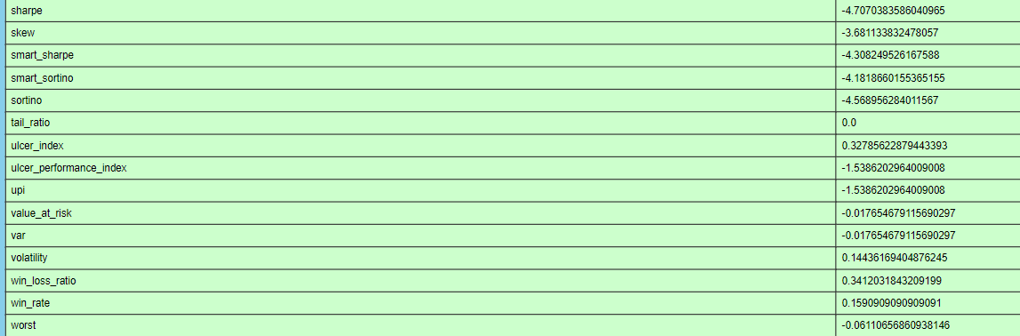
Output html page samples
Monthly return barplot
Trade based (reward) approach
Start_date=2022-09-01 End_date =2023-09-01

Slide 53

Output html page samples
Overall Returns :
Trade based (reward) approach
Start_date=2022-09-01 End_date =2023-09-01

Slide 54
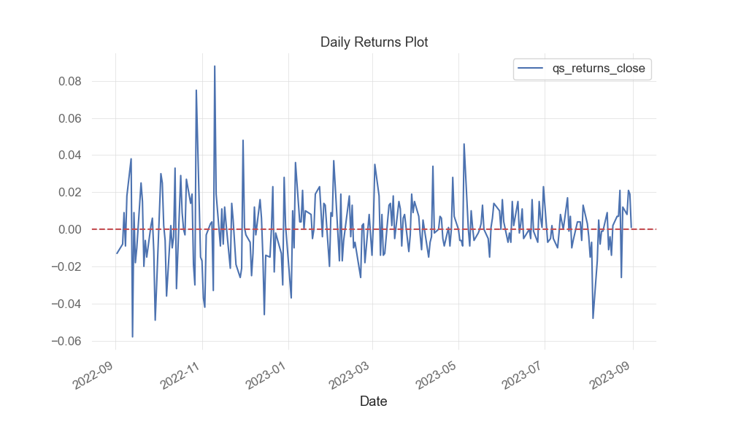
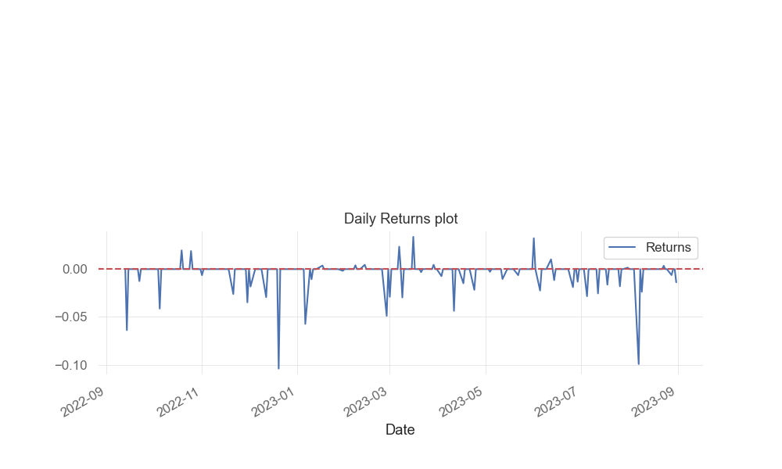
Timeframe:1day
Start_date=2022-09-01 End_date =2023-09-01
For market data (close price)- code based
For market data (close price)- manual based
Cumulative return: 0.210
For trade data (reward)- code based
For trade data (reward)- manual based
Cumulative return: -0.759

Slide 55
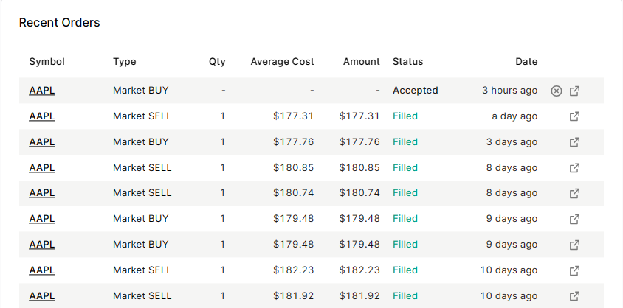
Order placing in alpaca
Orders (buy/sell) are placing alternatively

Slide 56
Other approaches tried
LSTM
RL Based LSTM
DQN
PPO
DDPG
Ensemble Approach

Slide 57
Challenges
A2C model is currently using for model training, getting issue for other models
Facing problems for fetching Real-time data from yahoo finance
Alpaca is taking hours to get filled the order after accepting the order. Due to this only one order is placing in a day. Paid alpaca versions can overcome this.
While running the code in office hours we are not

Slide 58
Thank you

Slide 59
LSTM approach
LSTM (Long Short-Term Memory) is an advanced type of recurrent neural network (RNN) designed to overcome the vanishing gradient problem and capture long-term dependencies in sequential data.
It uses memory cells and gating mechanisms to retain information and make accurate predictions even with large time lags.
LSTMs are effective in tasks like natural language processing, speech recognition, and time series analysis.

Slide 60
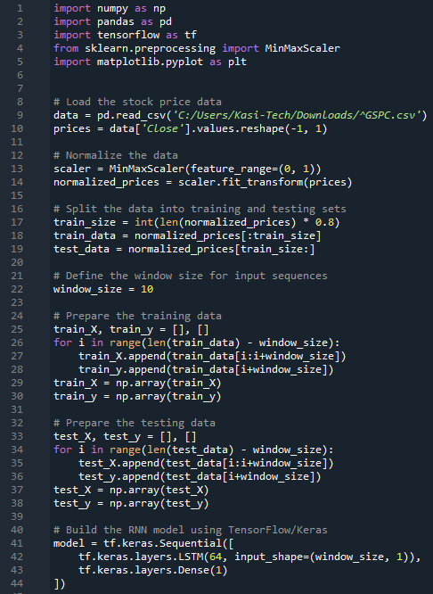
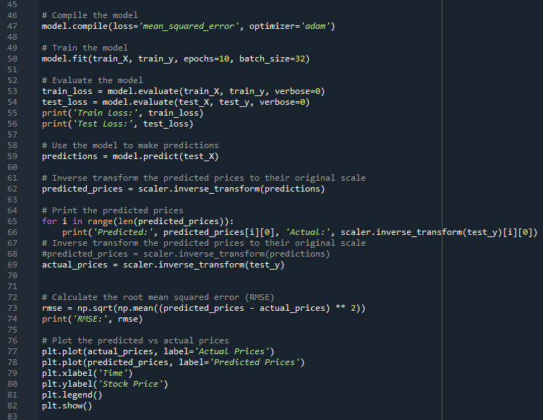
LSTM approach

Slide 61
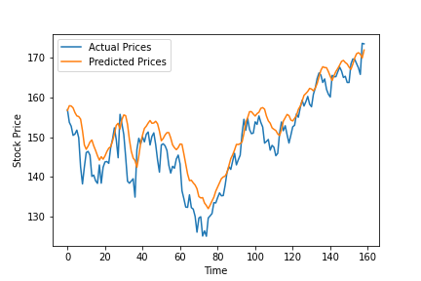
LSTM approach- Output sample
This method was for predicting only, buying and selling stocks part was not there

Slide 62
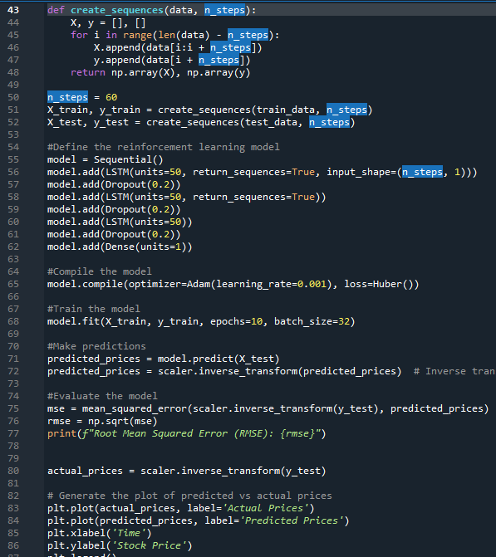
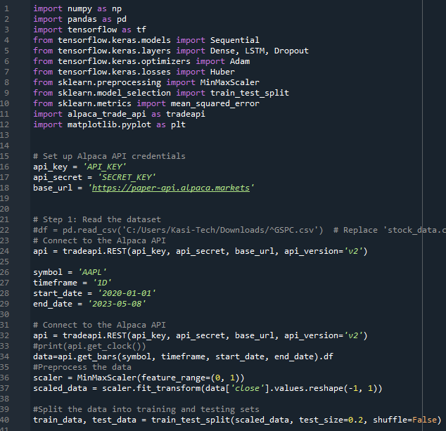
RL based approach

Slide 63
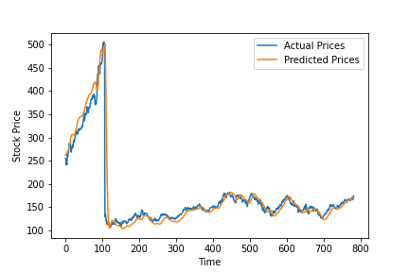
RL based approach- Output sample
This method was for predicting only, buying and selling stocks part was not there

Slide 64
DQN
DQN (Deep Q-Network) is a reinforcement learning algorithm that combines deep neural networks with the Q-learning algorithm.
It uses deep neural networks to approximate the Q-value function, which estimates the expected future rewards for taking a specific action in a given state.
DQN incorporates experience replay, storing past experiences in a memory buffer and randomly sampling them for improved learning efficiency.
With its off-policy learning approach, DQN learns from experiences generated by an older policy, making training more stable.

Slide 65
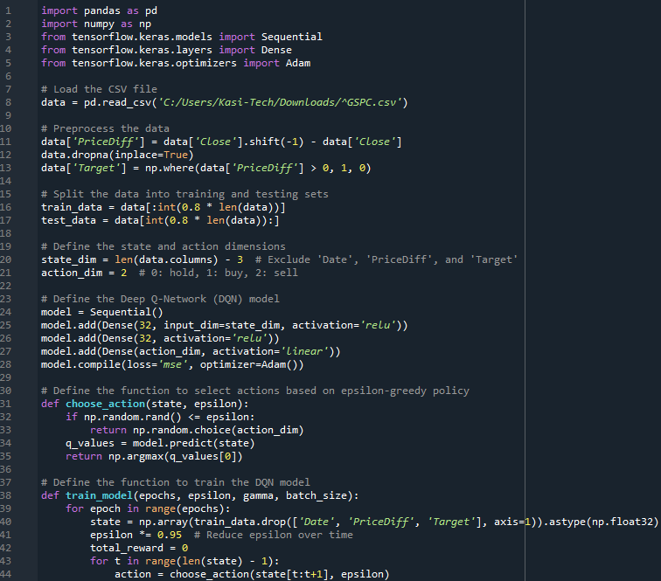
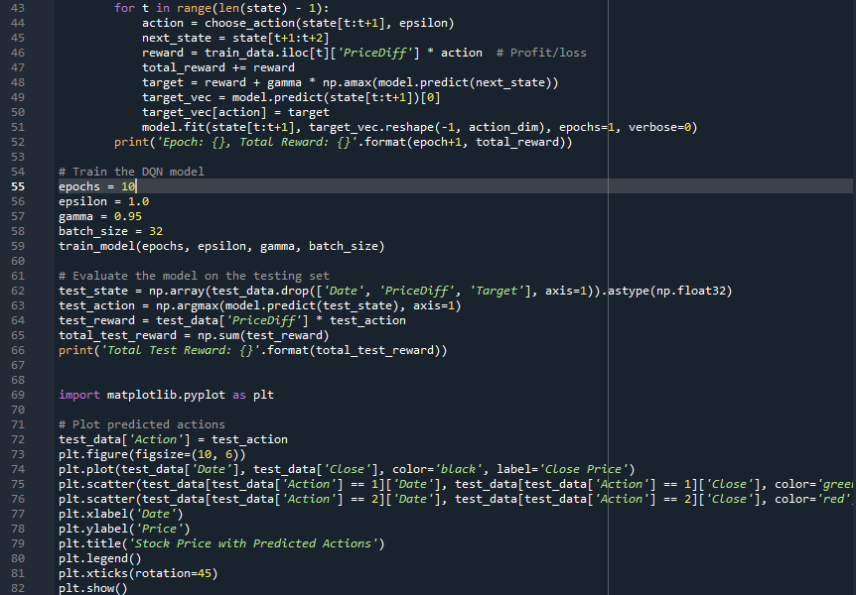
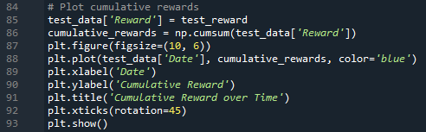
RL based DQN approach

Slide 66


RL based DQN approach- Output sample
Predicted actions
Cumulative rewards
For this model only buying is showing, selling not taking place, didn’t go forward as video reference was suggesting open ai’s deep RL methods

Slide 67
PPO (Proximal Policy Optimization)
PPO is a policy optimization algorithm that aims to strike a balance between sample efficiency and stability.
It leverages a surrogate objective function and utilizes a trust region approach for policy updates.
PPO addresses the issue of policy update sizes to prevent drastic policy changes.
It has gained popularity in trading due to its ability to handle both discrete and continuous action spaces.

Slide 68
PPO (Proximal Policy Optimization)
Advantages of PPO:
Trust Region Method: PPO uses a trust region approach, which constrains the policy update to ensure stable and incremental improvements, avoiding large policy updates.
Stable Policy Updates: PPO's policy update mechanism includes a surrogate objective function that discourages large policy changes, leading to more stable learning.
Sample Efficiency: PPO can achieve good performance with fewer samples compared to some other policy gradient methods, thanks to its efficient use of collected data.
Scalability: PPO is scalable and can be applied to high-dimensional action and state spaces, making it suitable for complex environments.

Slide 69
PPO (Proximal Policy Optimization)
Advantages of PPO:
Hyperparameter Sensitivity: PPO's performance can be sensitive to hyperparameter settings, such as the clipping parameter and learning rate, requiring careful tuning for optimal results.
Exploration: PPO may require additional exploration mechanisms, such as adding entropy regularization or exploration bonuses, to ensure sufficient exploration in challenging environments.
On-policy Learning: PPO is an on-policy algorithm, limiting the reuse of past experiences and making it less suitable for environments with non-stationary data distributions.
Local Optima: PPO's conservative policy updates may sometimes get trapped in local optima, limiting exploration and potentially hindering finding the global optimal policy.
In summary, PPO offers stable policy updates with a trust region approach, good sample efficiency, and scalability to high-dimensional spaces. However, it can be sensitive to hyperparameters, require additional exploration mechanisms, and may be prone to local optima.

Slide 70
DDPG (Deep Deterministic Policy Gradient)
DDPG is an actor-critic algorithm designed for continuous action spaces, making it suitable for trading.
It leverages deep neural networks to approximate the actor and critic functions.
DDPG utilizes a deterministic policy, enabling better exploration in continuous action domains.
It has been widely used for applications such as portfolio management and automated trading.

Slide 71
DDPG (Deep Deterministic Policy Gradient)
Advantages of DDPG:
Continuous Action Space: DDPG is well-suited for environments with continuous action spaces, allowing for fine-grained control.
Off-policy Learning: DDPG is an off-policy algorithm, enabling efficient use of past experiences stored in a replay buffer.
Actor-Critic Architecture: DDPG utilizes an actor-critic architecture, leveraging the actor to learn the policy and the critic to estimate the value function.
Target Networks: DDPG employs target networks, which help stabilize learning by providing target values that change less frequently.

Slide 72
DDPG (Deep Deterministic Policy Gradient)
Disadvantages of DDPG:
Exploration: DDPG can struggle with exploration in complex environments, often requiring additional exploration strategies like noise injection or exploration policies.
Hyperparameter Sensitivity: DDPG's performance can be sensitive to hyperparameter settings, requiring careful tuning to achieve good results.
Sample Efficiency: DDPG may require a large number of interactions with the environment to learn effectively, making it less sample-efficient.
Slow Convergence: DDPG can take longer to converge compared to other algorithms, particularly in high-dimensional or challenging environments.
In summary, DDPG is well-suited for continuous action spaces and offers off-policy learning with the actor-critic architecture and target networks. However, it may face challenges in terms of exploration, hyperparameter tuning, sample efficiency, and convergence speed.

Slide 73


DDPG

Slide 74


DDPG
Due to library error and environmental issue unable to execute the code

Slide 75
Backtrader API
Backtrader: A Powerful Framework for Backtesting Trading Strategies.
Backtrader is a popular open-source Python framework designed for backtesting trading strategies.
It provides a comprehensive toolkit for traders to simulate and evaluate strategies using historical data.
Backtrader empowers traders by offering a flexible and efficient platform for strategy development.

Slide 76
Back Testing
Backtesting plays a crucial role in the development and evaluation of trading strategies.
It allows traders to assess the potential performance and risks of a strategy using historical data.
Without backtesting, traders would rely solely on intuition and guesswork, exposing themselves to unnecessary risks.

Slide 77


Backtrader API

Slide 78


Backtrader API
This method was working fine with ‘quadl’ based data but currently getting some attribute issue, not using deep RL techniques.

Slide 79

Backtrader API

Slide 80
Ensemble Method in Reinforcement Learning
Ensemble methods combine multiple RL models or algorithms to improve overall performance.
Ensemble methods can include different RL algorithms, such as A2C, DDPG, or PPO, working together.
By aggregating the predictions or actions of multiple models, ensemble methods aim to achieve better performance and robustness.
Ensemble methods in RL can be beneficial for trading as they leverage diverse perspectives and increase decision-making accuracy.

Slide 81


RL based ensemble approach(PPO,A2C,DDPG)
Followed same code and dataset mentioned in the reference video link, getting value related errors.
Tried to correct issue by checking null values,index issues etc, but issues was getting

Slide 82


Slide 83


